Slide 1

Project 1: Jeopardy
Brian Walker

Slide 2

Identifying the problem
There’s no easy, web-based way for users to play a customizable, multi-player Jeopardy-style trivia game with automated scoring and category rotation.

Slide 3

Objectives
Implement a turn-based question-answering system using PHP forms.
Create a prize or score tracking mechanism with PHP sessions/cookies.
Add a feature to randomized questions with different difficulty levels.
Ensure a visually engaging UI with CSS transitions/animations

Slide 4
Key challenges
Not allowed to use JavaScript
Designing system to display questions linked to answers with proper logic
Implementing randomization of questions with question/answer logic system
Implementing cookies/sessions to track scores and switch between player 1 and 2
Marking previously selected questions as used/inaccessible

Slide 5
Solution Overview
A PHP-based, browser-friendly Jeopardy game for two players.
Questions are loaded dynamically from a .txt file for easy editing and scalability.
Automatically selects 5 random categories per game to keep each session fresh.
Score is tracked and displayed in real-time, with correct/incorrect answer feedback.
A live leaderboard is generated as an HTML file for persistent post-game viewing (currently not working via codd server)

Slide 6
See it in action
Jeopardy - The Game

Slide 7
Demo Recap
https://github.com/iambrianwalker/jeopardy.git
Notes:
Just speak on it. Too much text

Slide 8
Code architecture
Built using PHP with HTML for rendering and basic CSS for styling.
State is tracked using PHP sessions ($_SESSION) to manage game progress.
Game logic includes:
Reading and parsing a question file.
Generating a random game board.
Handling player turns and score updates.
Exporting a live leaderboard to an HTML file

Slide 9
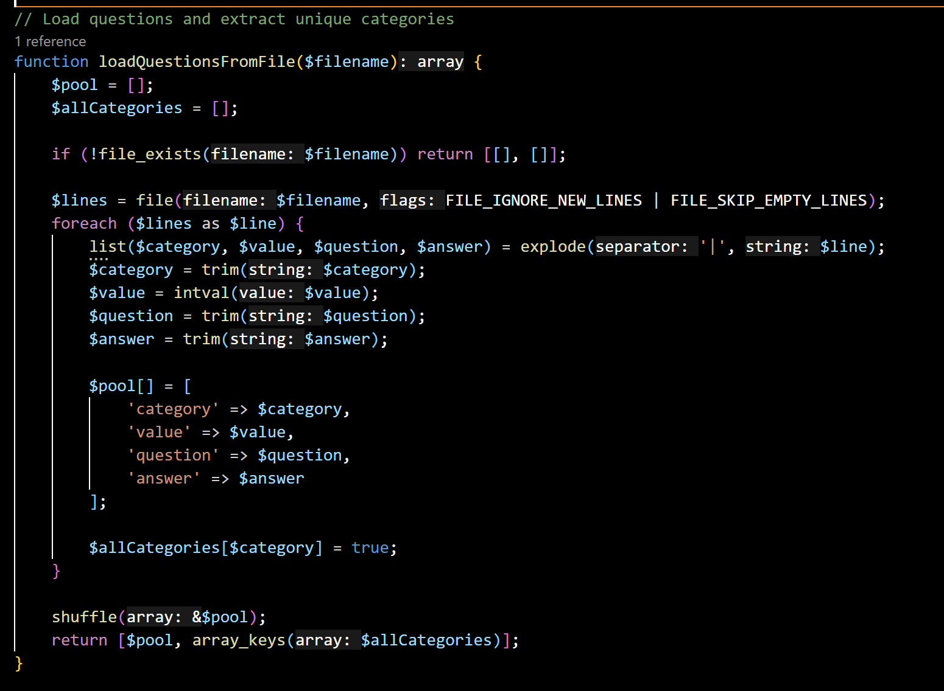
Load questions from .txt file
Key Function: loadQuestionsFromFile()
Content:
Reads questions.txt where each line =
Category | Value | Question | Answer
Parses, trims, and stores into an array of question objects.
Extracts all unique categories and returns both.

Slide 10
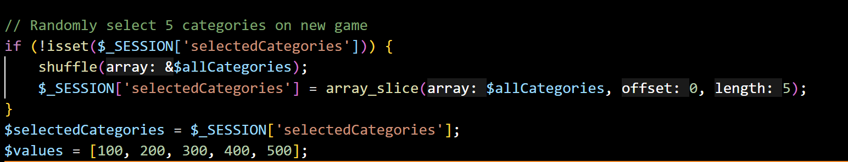
Session based game setup
First-time load: initializes session variables:
players, currentPlayer, usedQuestions, questions, answers
Picks 5 random categories from all available ones.
Populates $board and $answers arrays from the full pool.

Slide 11
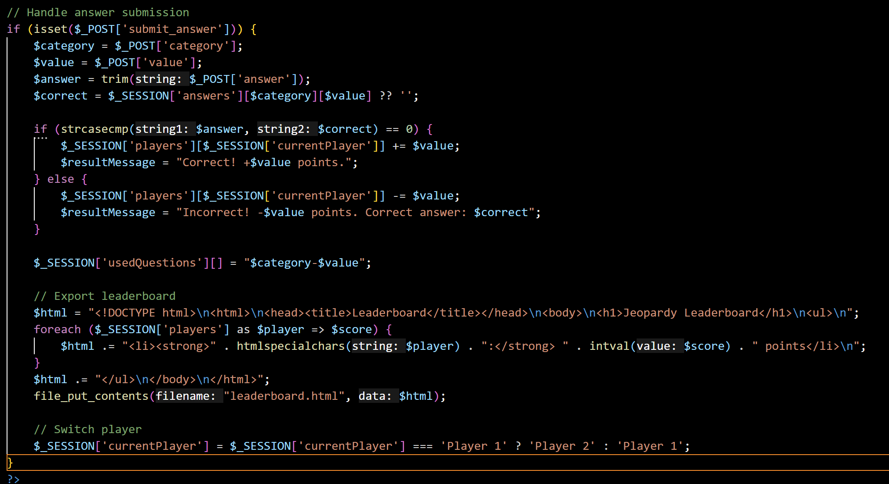
Handling answers and switching turns
When a user submits an answer:
It checks correctness (case-insensitive).
Updates the player’s score.
Saves question to used list.
Exports scores to leaderboard.html.
Switches turn.

Slide 12
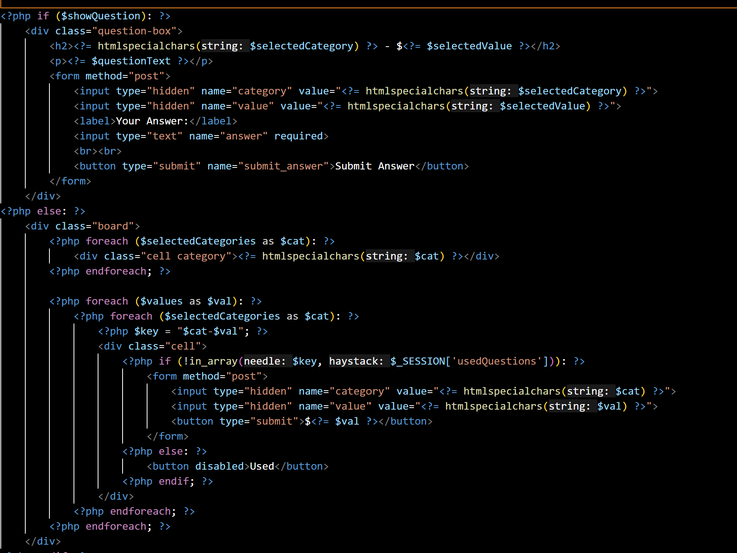
Game interface logic
Dynamic HTML generation based on current game state.
Questions are shown only when a value is clicked.
Used questions are grayed out / disabled.
Game board is rebuilt each page load using session state.

Slide 13
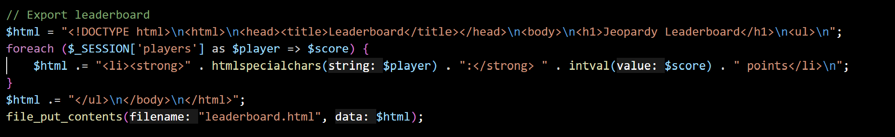
Generating the leaderboard
Every turn triggers an export of scores to leaderboard.html
HTML is dynamically generated in PHP.
Allows persistent, viewable results post-game.

Slide 14
Sources
https://www.w3schools.com/php/php_examples.asp | PHP general manual
https://www.w3schools.com/php/php_forms.asp | More info on php forms
https://www.php.net/manual/en/function.array-slice.php | Array Slice Function
https://www.php.net/manual/en/function.shuffle.php | Shuffle Function
https://www.php.net/manual/en/function.trim.php | Trim function
https://www.php.net/manual/en/function.explode.php | Explode function
https://www.php.net/manual/en/function.file.php | File function
https://www.w3schools.com/php/php_sessions.asp |PHP Sessions Info
https://youtu.be/58_UCvQBz4Y?si=uF8LTWD2ihVm_g5f | PHP Sessions Tutorial
https://youtu.be/ALaSX1g9H6E?si=mKxZQfrL__TRxfai | HTML CSS PHP Jeopardy Project Example
ChatGPT | Creating questions and categories because I’m lazy

Slide 15

THANK YOU

